Slide 1
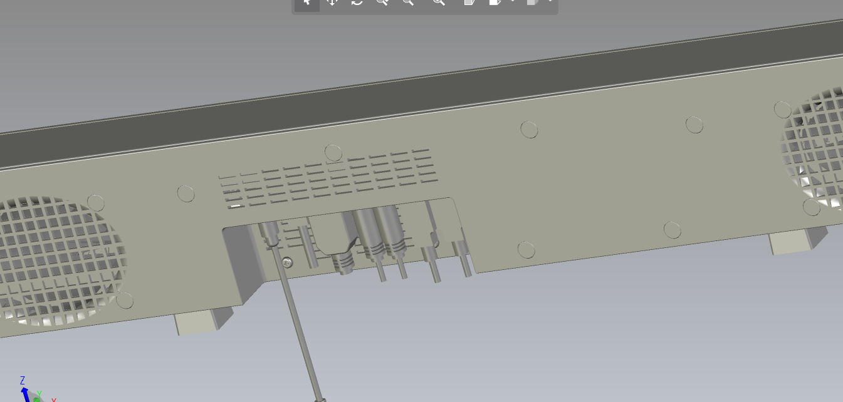
[20210518_ALT]
Delete Vent holes
[20210518_ALT]
Delete Vent holes

